Slide 1
UVAR Box Status update

Slide 2
UVAR BOX
WP0Leader - pedro.barradas@armis.pt
European Commission Directorate-General for Mobility and Transport Desk Officer: Fons VERHELST
Notes:
Preparatory Action supported by the EU Parlaimant and coordinated by EU Commission DG Move

Slide 3
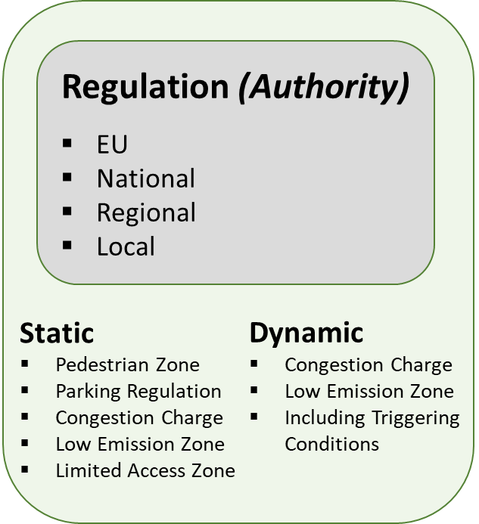
UVAR Schemes TODAY
Implementing Authority
Publication
Paper
Notes:
Geographical- Spatial scope
time periods (time of day, day of the week, etc.)
vehicle weight or size (e.g., maximum permitted height, width, length dimensions; maximum gross / unladed or axle weights)
Usually it implies a payment of a certain fee
However UVAR are NOT always integrated into a larger transport and mobility plan as they are:
Language dependent;
Reflecting local ‘cultural’ subtleties;
Traffic Regulations issued by public authorities at local, regional or national level;
Sometimes Creative and refined which contrasts with other TR’s predictable and regular.
…therefore, often misunderstood by the public, in particular the EU road users (both professional and non-professional), particularly impacting free movement of people across the EU.

Slide 4
UVAR Tool Box concept design
Implementing Authority
Publication
Implementing Authority
Publication
Digital m2m readable format DATEX II
+ Pre-formatted Word.doc
Notes:
Combined schemes
There are increasingly schemes that are a combination of different scheme types. For example, LTZs that have emissions requirements and payment for permits, or LEZs that are implemented by a charging mechanism. that best suits them, and the other aspects will be mentioned.
Semantics
Geographical scope of UVARs covered by UVAR Box
All five types of UVARs described above (LEZs, CSs, LTZs, PARKs, PEDs), in all EU member states, where details are known, will form the shaping content of the DATEX II data model and attended to in the UVAR Box software tools development.
The effort to organise the use of the UVAR Box tools and propose a stepwise approach for cities to begin the generation of their digital UVAR schemes will firstly focus on LEZs in five selected pilot Member States: Austria, Belgium,

Slide 5
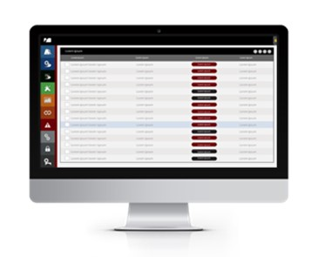
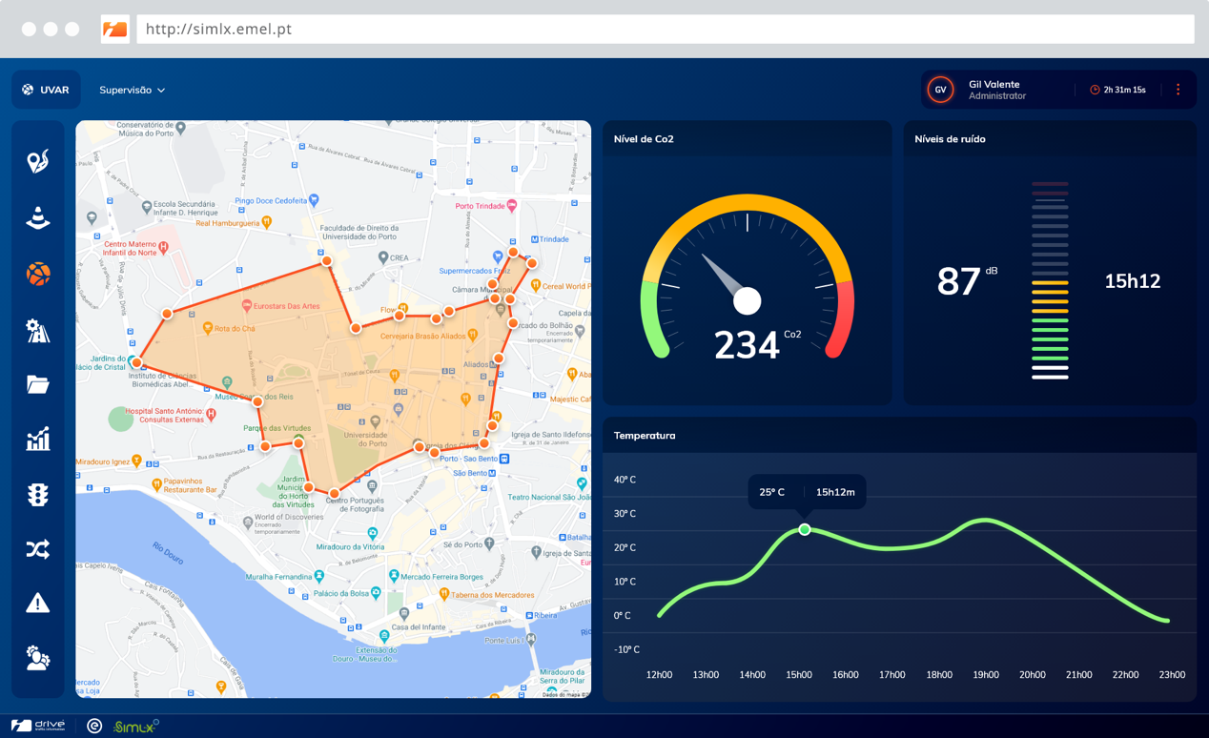
UVARBox Schemes in the near FUTURE
Digital m2m readable format DATEX II
+ Pre-formatted Word.doc
Notes:
How will this work in practice?
UVAR data attributes to be collected and translated into a machine-readable format
Administrative data – by the competent authority(ies) while issuing the regulatory document of the UVAR and the date when it was issued
Type of regulation - Low Emissions Zones (LEZ), Congestion Charges (CS), Limited Traffic Zones (LTZ), Parking Regulations (PARK) and Pedestrian Zones (PED)
Time validity - the period in which the regulation(s) applies
Activation processes of triggered dynamic UVARs - There are different triggering mechanisms; in the case of Northern Italy, the emergency pollution schemes are activated automatically by the regional air quality levels, for example, while in France it is a combined decision from city and region.
Location - There might be one location for each UVAR or several locations for different types or phases
Applicability conditions - a permit/sticker, etc., can be issued
And Exemptions!!! - vehicle categories like electric vehicles or certain trips like delivery services, permissions for registered tradesperson, vehicles performing a specific function or roles (such as postal service vehicles), or certain drivers (such as residents or disabled),

Slide 6
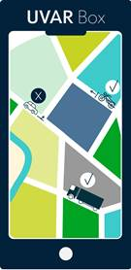
UVARBox Schemes in the near FUTURE
Digital m2m readable format DATEX II
+ Pre-formatted Word.doc
Notes:
UVARBox tools are designed to:
enable the provision of accurate, up to date, continuous and interoperable EU-wide real-time traffic information services.
support cities streamlining and simplifying the digital procedures for issuing such schemes, at the level of the National Access Points.

Slide 7
UVAR Box Project outline
TOOL BOX for M2M UVAR
NEW PROCESSES for Authorities
NEW LANGUAGE + COACHING
In sum, UVARBox tools are designed to:
enable the provision of accurate, up to date, continuous and interoperable EU-wide real-time traffic information services.
support cities streamlining and simplifying the digital procedures for issuing such schemes, at the level of the National Access Points.
by means of developing the adequate machine-readable formats in DATEX II, that navigation systems, or mobile applications may use.
Piloting Member States – AU, BE, DE, IT and NL

Slide 8
UVARBox Project Organisation
UVAR Data MODEL DEFINITION
The objective to propose a definition and structuring of UVAR data, define and develop, leading to the finalisation of the European DATEXII profile for UVAR
UVAR Data GENERATION
The objective is to establish the organisational and technical foundations for the UVAR data generation and for the long-term data maintenance after the project end.
UVAR Data PROVISION
The objective is to support the integration of UVAR data accessible in National Access Points into pre-trip and on-trip information services provided to end users.
Encoding details (e.g. as MS Word or html) will be aligned with SDG requirements.
COMMUNICATION AND OUTREACH STRATEGY + Country Coaches
SUSTAINABILITY STRATEGY

Slide 9
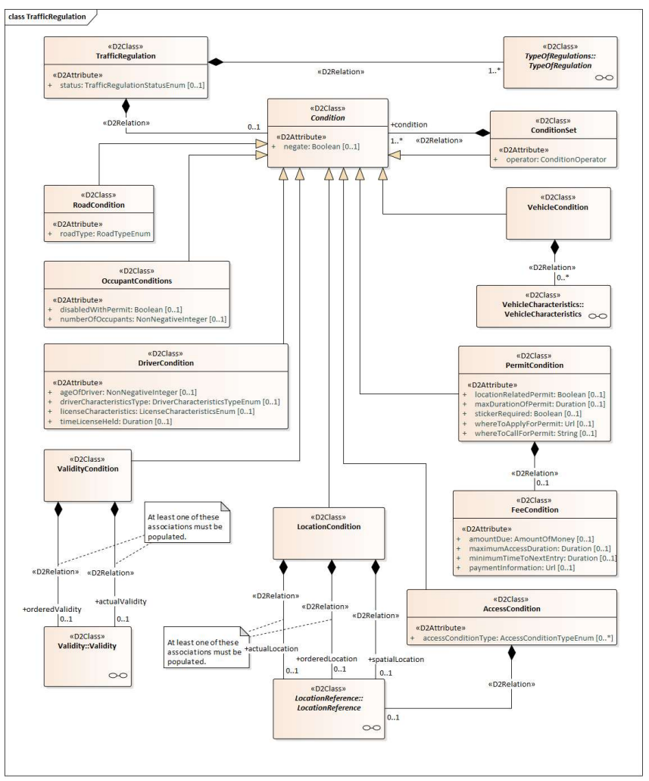
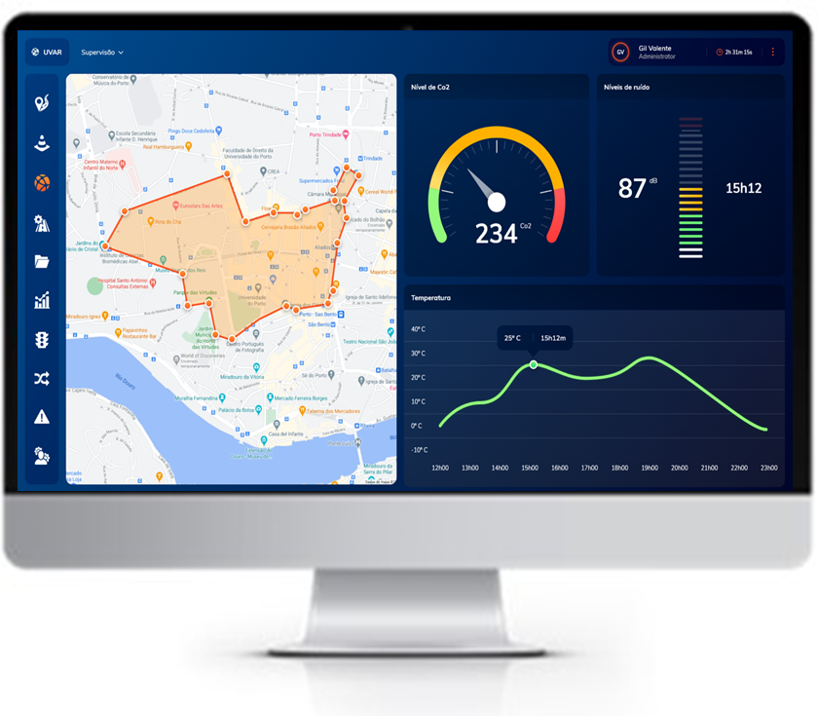
UVARBox Project Organisation
UVAR Data MODEL DEFINITION
The objective to propose a definition and structuring of UVAR data, define and develop, leading to the finalisation of the European DATEXII profile for UVAR
UVAR Data GENERATION
ve is to establish the organisational and technical foundations for the UVAR data generation and for the long-term data maintenance after the project end.
UVAR Data PROVISION
Encoding details (e.g. as MS Word or html) will be aligned with SDG requirements.
COMMUNICATION AND OUTREACH STRATEGY + Country Coaches
SUSTAINABILITY STRATEGY

Slide 10
UVARBox Project timeline
Kickoff Ago2020|Jul2021
Interim Report Ago2021|May 2022
Final Report Ma|Ago2022
Inception Report
Communication strategy
Project leaflet
Stakeholder workshop 1 supporting WP1
UVAR state of the art report
Structure for different data sets relevant for the definition of UVARs
Stakeholder Workshop 2 together with WP2
Final report
Organisation of a hackathon at TRA2022
UVAR data access in navigation services
Report on organisational frameworks in place concerning the publication of UVARs, including legal framework conditions for data access and data provision
DATEXII Profiles for UVAR data Exchange and Template for SDG
5 capacity building webinars
UVAR tool package + development report
Specification of UVAR related data-flows for data collection and data maintenance
Technical documentation and user documentation of UVAR tool

Slide 11
Thank you
WP0Leader - pedro.barradas@armis.pt
European Commission Directorate-General for Mobility and Transport Desk Officer: Fons VERHELST

