Slide 1
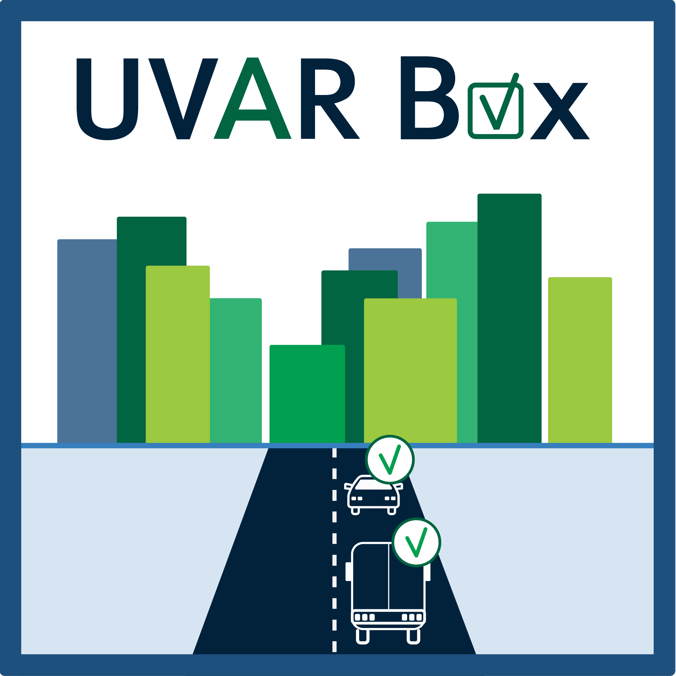
National Stakeholders‘ Engagement

Slide 2
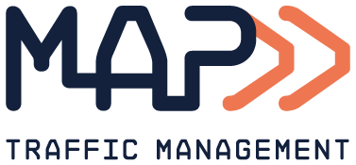
BELGIUM
MAPtm country coach
Mobility management service provider
Mobility Innovation and digitalization initiatives
Strategy development to operational implementation
Supporting public and private mobility organizatons

Slide 3
BELGIUM
National framework for UVAR complemented with a regional frameworks and cities policies and regulations;
NAP Multimodal Travel Information Services operational; NAP RTTI planned
3 Low Emission Zones (combined with LTZ or PED) in Brussels, Antwerp and Gent; Plans for new LEZ and LTZ in Flanders and Wallonia (2023)
Brussels is implementing Congestion Charge (Smart move) planned start in 2022
UVAR digitalization activities are city driven and available via city Open Data Portals
Flanders Mobilidata program supporting mobility digitalization

Slide 4
BELGIUM
Explore options and feasibility for implementing UVAR DATEXII model with “frontrunners” > Q3-2021
Provide UVAR DATEX II model and support with UVAR examples applications > Q3 - 2021
Integration in own tools
Use of UVARbox tool > Q1-2022
Frontrunner cities publish the UVARbox data through city opendata portal / NAP > Q1-2022
Provide UVARbox tool and training to cities through workshops > Q2-2022

Slide 5
National Stakeholders‘ Engagement

Slide 6
THE NETHERLANDS
National Smart Mobility policy plan aiming scale up mobility digitalization
National framework for LEZ (“Milieuzones”) and “Zero Emission Zones” (urban logistics)
UVAR digitalization related national programs: “Digitaliseren logistiek” and “Regional Data Teams”
4 cities with LEZ (and LTZ or PED) and 13 cities LEZ heavy duty vehicles
4 cities with Limited Traffic Zones (and or PED)
Parking regulations ~125 cities
National Access Point (NDW and RDW) operational and DATEX II compliant

Slide 7
THE NETHERLANDS
Provide UVAR DATEX II model to UVAR Digitalization Service provider and NAP > Q3 -2021
Coordinate with NAP the options for availability of UVAR info in 2022 > Q3 – 2021
Provide UVARbox tool to “Digitalization programs” and “Regional Data Teams” > Q2-2022
Provide Online training and support to cities for use at medium long term > Q2-2022
Collaborate with national stakeholders on UVARdata updates & quality control > Q2 - 2022

