Slide 1
Preparatory Action User-friendly Information Tool on Urban and Regional Access Regulations Schemes Contract: MOVE/B4/SER/2019-498/SI2.832125 UVAR Box Workshop 24.11.2020
European Commission Directorate-General for Mobility and Transport Desk Officer: Fons VERHELST

Slide 2
Urban Vehicle Access Regulations
Urban Vehicle Access Regulations (UVAR) have been established across European Cities, under different schemes aiming to positively impact the reduction of emissions, traffic congestion or, simply, to return back to pedestrians and cyclists, the most scarcest resource in the city: urban space.
However UVAR are Not always integrated into a larger transport and mobility plan and are:
Language dependent;
Reflecting local ‘cultural’ subtleties;
Traffic Regulations issued by public authorities at local, regional or national level;
Creative and refined which contrasts with other TR’s predictable and regular.
…therefore, often misunderstood by the public, in particular the EU road users (both professional and non-professional).

Slide 3
Urban Vehicle Access Regulations
With the intention to push for a much more effective use of UVAR and adequately inform road users about such schemes, when moving across the EU, the EC has commissioned the development of a set of tools – the UVAR Box – designed to:
enable the provision of accurate, up to date, continuous and interoperable EU-wide real-time traffic information services.
support cities streamlining and simplifying the digital procedures for issuing such schemes, at the level of the National Access Points.
by means of developing the adequate machine-readable formats in DATEX II, that navigation systems, or mobile applications may use.

Slide 4
UVARBox Scope
Low Emission Zones restrict access by the most polluting vehicles to a specific area within a city at all times. Often LEZs are implemented as a measure to address harmful air pollution from road vehicles, in particular where and when EU air quality standards are breached.
Parking regulations include all forms of parking measures intended to control the availability and price of parking spaces, thus creating incentives for accessing specific zones by alternative modes of transport.
Congestion charging schemes monetise access to a certain zone of a city, which gives a price incentive for drivers to switch to other modes of transport or travel times. They levy a toll or charge on certain roads, which (without the charge) are often congested - most often in city centres.

Slide 5
UVARBox Scope
Limited traffic zones allow cities to regulate access by methods other than payment or differentiating vehicles by emissions categories, such as Euro standards. It is an area where cars are controlled through special permits, usually in order to protect historic centres, the road infrastructure or to increase road safety.
Pedestrian zones are reserved areas of a city or town for pedestrians (sometimes covering also other active modes of transport, such as cycling), with a ban on most or all automobile traffic, often with exemptions for deliveries and other specific needs.

Slide 6
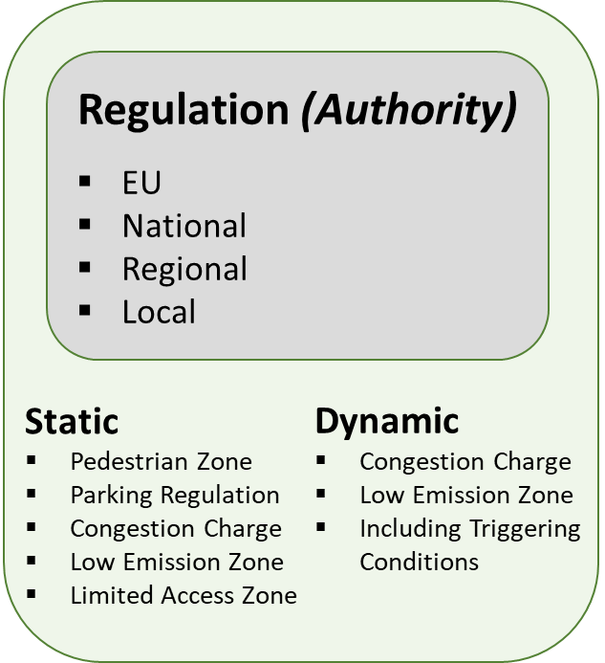
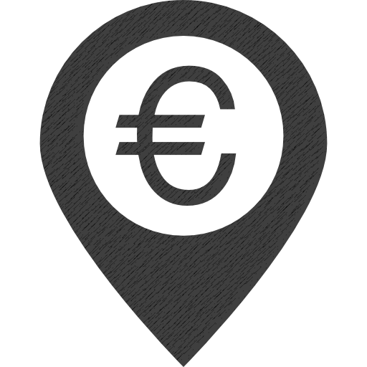
UVAR today
Implementing Authority
Publication
Paper

Slide 7
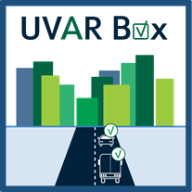
UVAR Box concept design
Implementing Authority
Publication
Implementing Authority
Publication
Digital m2m readable format DATEX II
+ Pre-formatted Word.doc

Slide 8
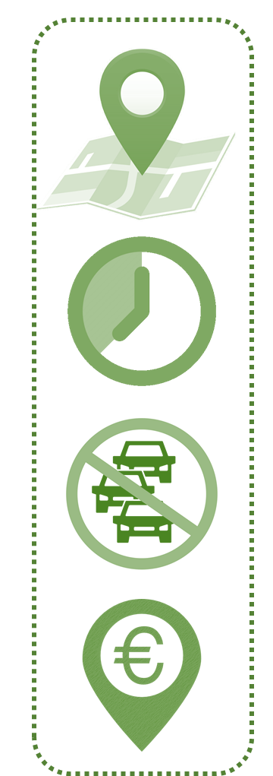
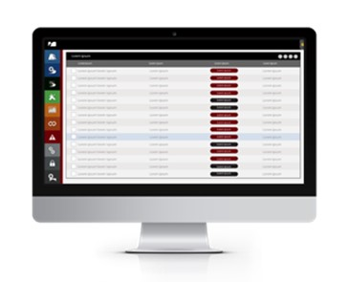
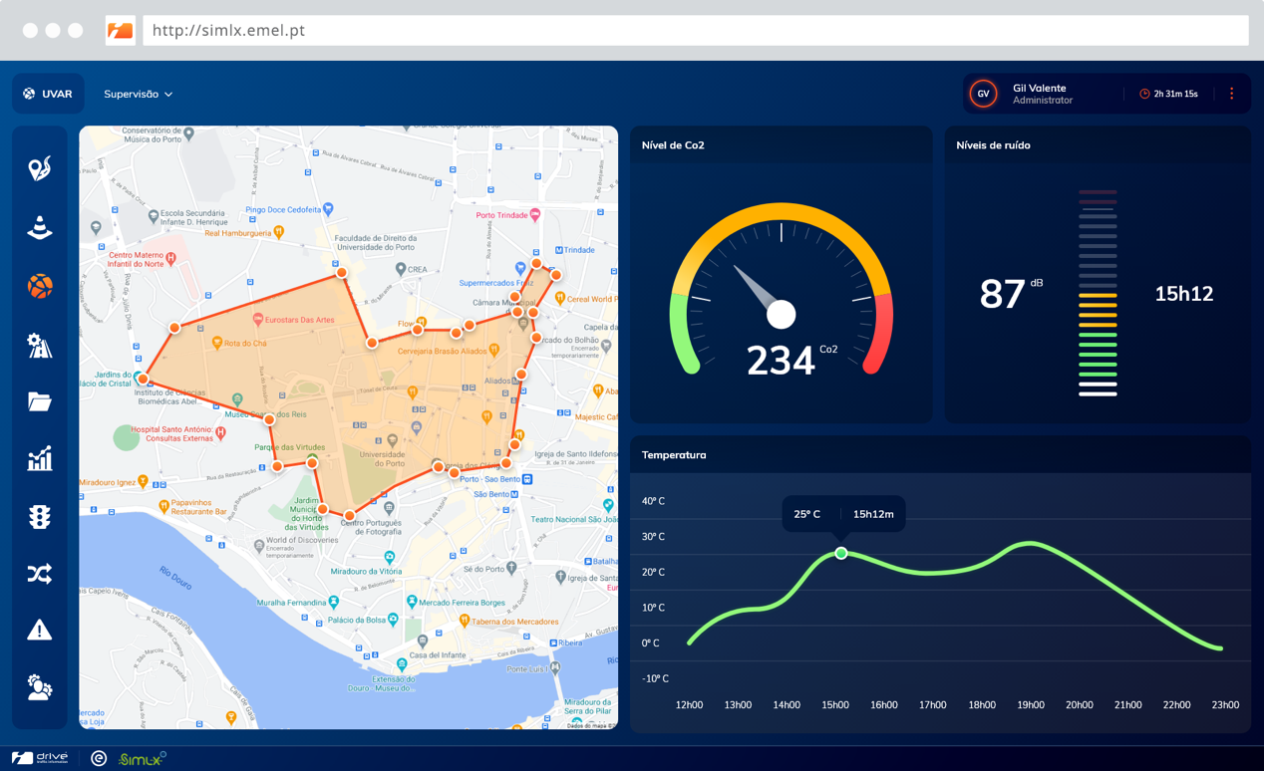
UVARBox in the future
Digital m2m readable format DATEX II
+ Pre-formatted Word.doc

Slide 9
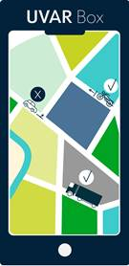
UVARBox in the future
Digital m2m readable format DATEX II
+ Pre-formatted Word.doc

Slide 10
for the next 2 years
WP 1: UVAR data definition, structuration and exchange
WP 2: UVAR data collection and maintenance
WP 3: Development and provision of UVAR information services
WP 4: Definition of a strategy to ensure the sustainability of data collection and accessibility
WP 5: Stakeholder engagement and Communication support
+Country Coaches – reputation, expertise and networking
Reaching out and bringing together the UVAR competent authorities (cities and regions), National Access Point community, the Member States, the Service Providers and the Single Digital Gateway National Coordinators is critical for the success and appropriate use of the UVAR Box.

Slide 11
Preparatory Action User-friendly Information Tool on Urban and Regional Access Regulations Schemes Contract: MOVE/B4/SER/2019-498/SI2.832125 WP0Leader - pedro.barradas@armis.pt
European Commission Directorate-General for Mobility and Transport Desk Officer: Fons VERHELST

